Slide 1
GoF State Pattern
Aaron Jacobs
State(305) Allow an object to alter its behavior when its internal state changes. The object will appear to change its class.

Slide 2
Applicability
An object’s behavior depends on its state, and it must change its behavior at run-time depending on that state.
Operations have large, multipart conditional statements that depend on the object’s state. This state usually represented by one or more enumerated constants. The State pattern puts each branch of the conditional in a separate class. This lets you treat the object’s state as an object in its own right that can vary independently from other objects.

Slide 3
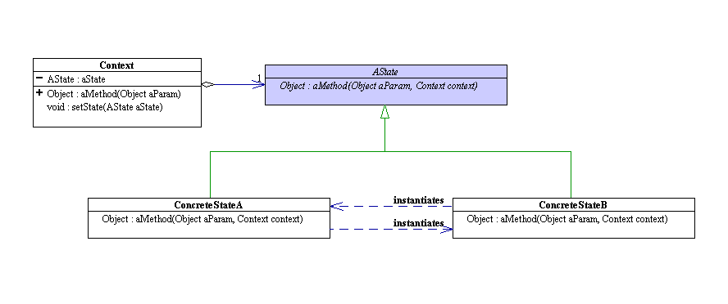
Structure

Slide 4
Participants
Context
  Defines the interface of interest to clients.
  Maintains an instance of a ConcreteState subclass that defines the current state.
State
  Defines an interface for encapsulating the behavior associated with a particular state of the Context.
ConcreteState subclasses
  Each subclass implements a behavior associated with a state of the Context.

Slide 5
Collaborations
Context delegates state-specific requests to the current ConcreteState object.
A context may pass itself as an argument to the State object handling the request. This lets the State object access the context if necessary.
Context is the primary interface for clients. Clients can configure a context with State objects. Once a context is configured, its clients don’t have to deal with the State objects directly.
Either Context or the ConcreteState subclasses can decide which state succeeds another and under what circumstances.

Slide 6
Consequences
It localizes state-specific behavior and partitions behaviore for different states.
It makes state transitions explicit.
State objects can be shared.

Slide 7
Possible Issues
If there are many different states that all need to have transition functions to one another, the amount of transition code required could be massive.
Switch(State)
case A: …
case B: …
etc…

Slide 8
Known Uses and Related Patterns
Popular interactive drawing programs use the State pattern to perform specific operations based on which State(tool) is selected.
The Flyweight (195) pattern explains when and how State objects can be shared.
State Objects are often Singletons(127).

Slide 9
References
State Pattern Picture:
  http://exciton.cs.rice.edu/JavaResources/DesignPatterns/StatePat.htm
Design Patterns, Elements of Reusable Object-Oriented Software
  Erich Gamma, Richard Helm, Ralph Johnson, John Vlissides

